Slide 1
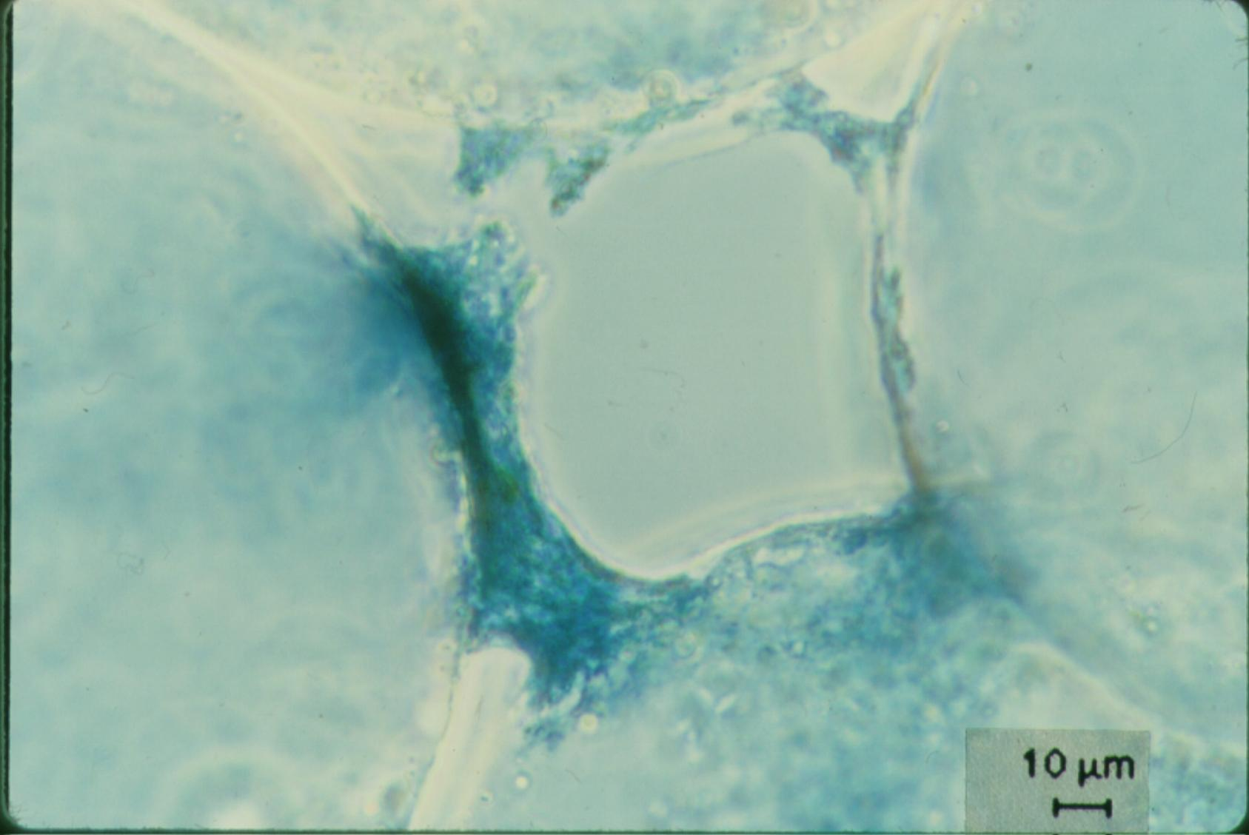
Filtration Model
On removing little particles with big particles

Slide 2
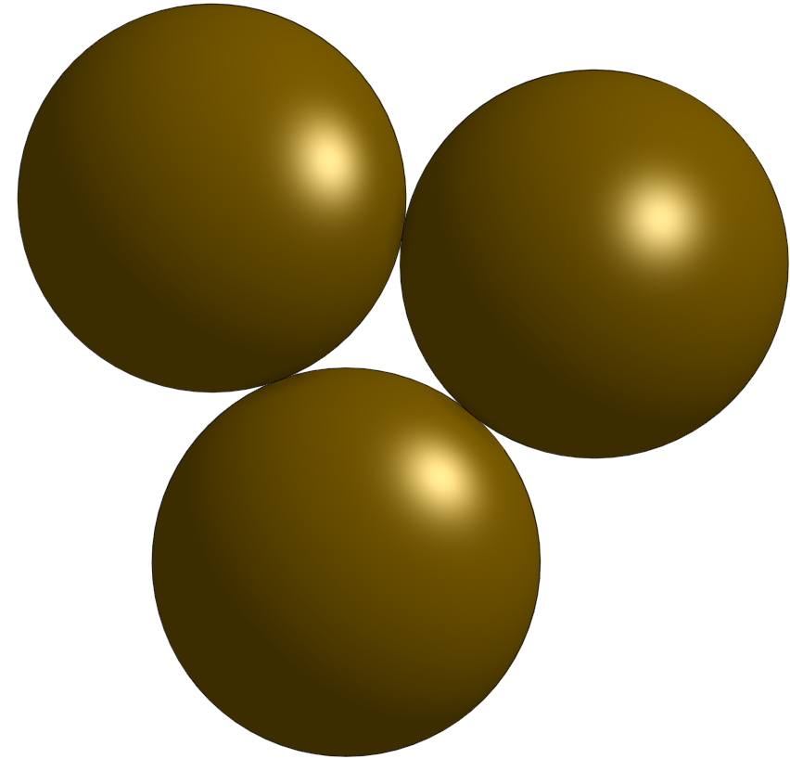
Filtration mysteries
Filter pores are gigantic compared with the particles that they remove
Filters work better after “ripening”
Clean sand is a lousy filter!!!!
Filters don’t fail by clogging! They fail because particles start leaking through
Only a tiny fraction of the pore volume is filled with captured flocs and particles
What is the actual filter?
Floc filters have limited capacity too!
What is happening inside those pores?

Slide 3
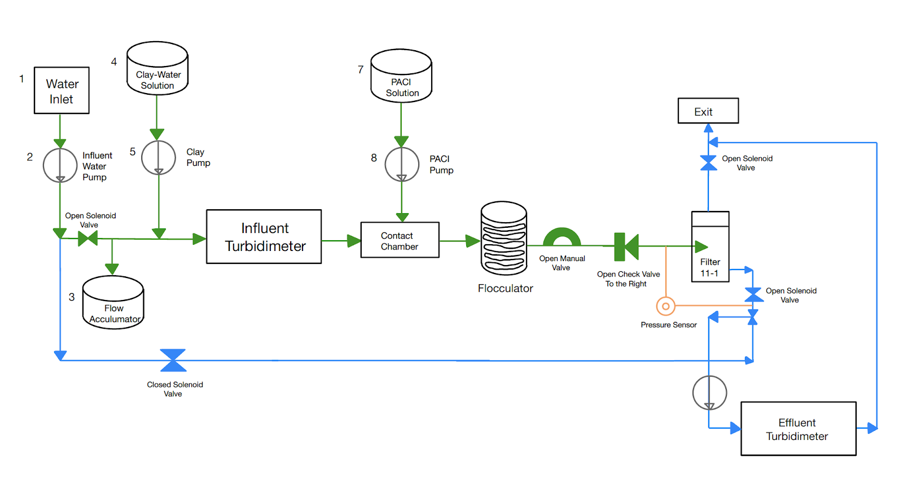
Direct filtration, so this wasn’t after plate settlers…

Slide 4
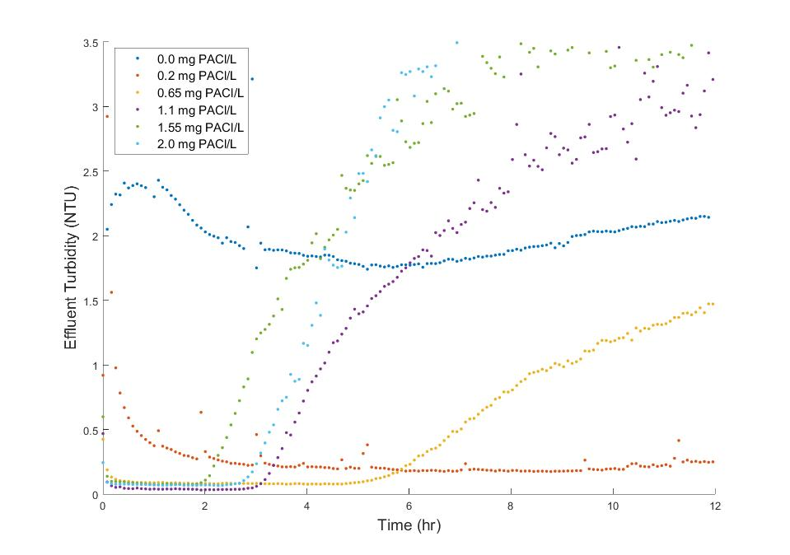
Very steep failure
1.55 mg/L
5 NTU raw water
Direct filtration
(no clarifier)
20 cm deep filter
0.65 mg/L
Lucinda Li, Theresa Chu, Jonathan Harris, Mythri Krishnamoorthysujatha, Rose Linehan, William H. Pennock
Notes:
Lucinda Li, Theresa Chu, Jonathan Harris, Mythri Krishnamoorthysujatha, Rose Linehan, William H. Pennock

Slide 5
Active filtration zone slowly moves down through the filter
Head loss
Turbidity
Time

Slide 6
Active Filtration zone
Backwash debris
Active zone breakthrough
(large flocs likely get to the bottom of the filter first)
Loaded zone
Filtration improves while loaded zone expands and clean zone shrinks
Therefore particle removal is better in loaded zone than in clean zone!
Why is it “loaded”?
Active Filtration zone
NTU
Clean zone
Time

Slide 7
Evolving Constriction Geometry
Constriction height (or thickness) set by size of captured flocs
Constriction minimum opening size set by the bond strength of the coagulant!

Slide 8
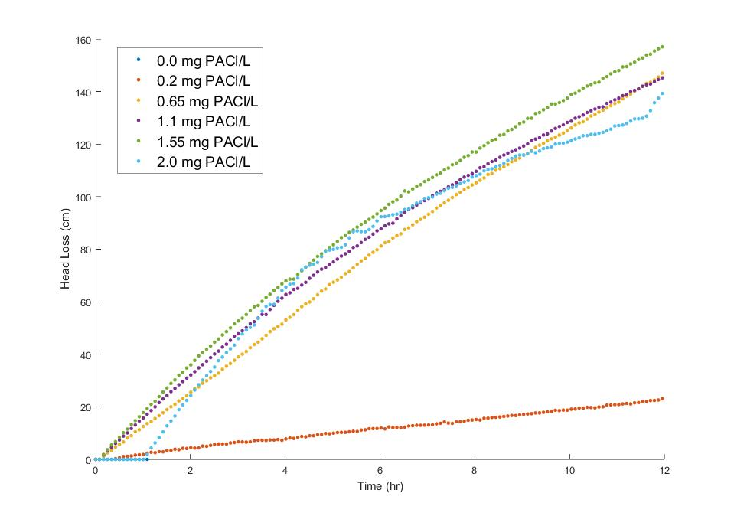
Head loss in Filters is close to linear before breakthrough
0.65 mg/L
1.55 mg/L
Breakthrough
Notes:
With bigger flocs there is less head loss at breakthrough!
With bigger flocs there is more head loss per mass of particles removed

Slide 9
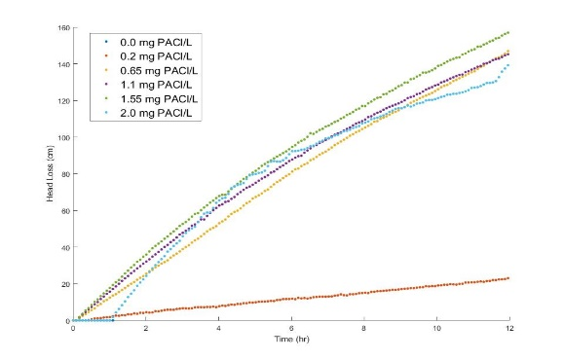
Head loss and filter-fraction-loaded increase linearly together
Head loss continues to increase after the active zone reaches the filter effluent
Head loss increases MORE SLOWLY after the active zone reaches the filter effluent
Either pores are slowly constricting more
Or the flocs that make the constriction are becoming less porous as they fill up with small particles
Loaded zone
Active Filtration zone
Clean zone

Slide 10
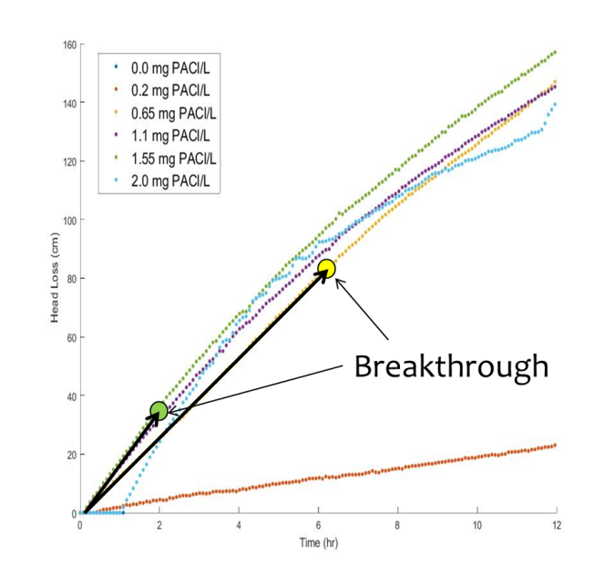
Breakthrough happens sooner with higher coagulant dose!
Why does increased coagulant dose result in earlier failure?
bigger flocs occupy more volume AND they aren’t able to attach to partially filled constrictions
Why is head loss accumulation faster with more coagulant?
bigger flocs must occupy more plan view area of a constriction
Still working to understand all of this!
1.55 mg/L
0.65 mg/L
Notes:
Remember that these experiments were direct filtration (no sedimentation!)
Thus it is the big flocs that exit the filter first!!!!
Big flocs are likely harder for constrictions to capture because of the higher shear (same reason why big flocs are likely not captured as well in floc blankets)

Slide 11
Flocs deposit at the smallest pore formed by the sand where streamlines converge
No removal by interception in straight tube
Particles are deposited at the constriction
The biggest part of the filter pore remains empty!
Big particles can’t attach to partially filled restrictions

Slide 12
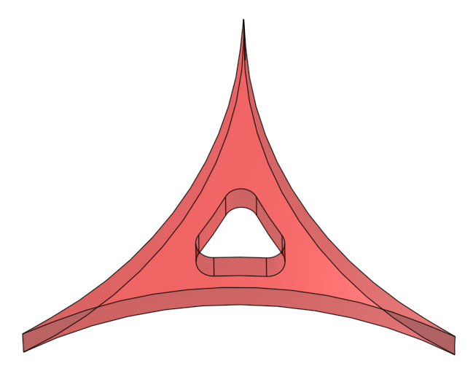
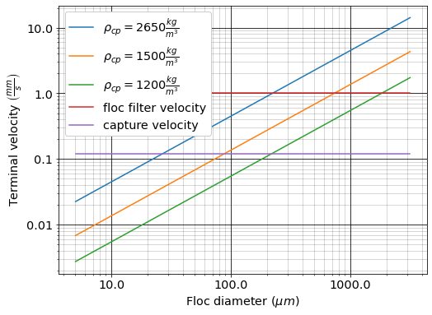
Filter pore physics
The constriction might be made of the larger flocs that escaped the plate settlers
27 μm

Slide 13
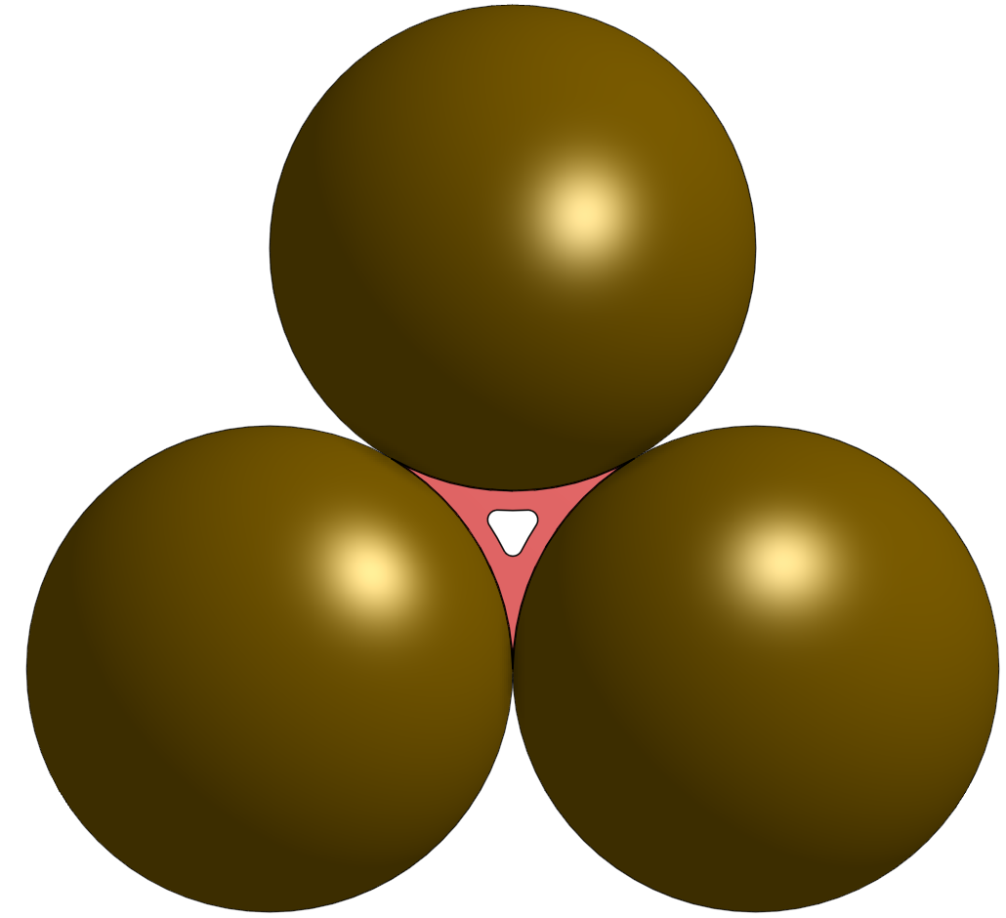
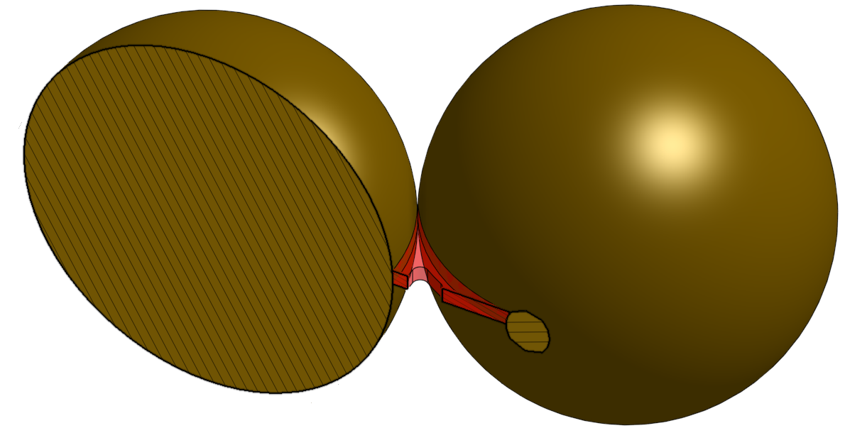
Pore constriction
0.5 mm
The floc volume that “fills” a filter is VERY tiny compared with the sand pore volume

Slide 14
Pore Physics
The pore is an orifice! (minor losses)
Might have a vena contacta
Flow expansion has minor loss
Has a minimum size because as v increases drag increases and flocs can’t attach
The flocs that make up the constriction are porous
Some of the flow goes right through the red flocs!
Flocs slowly become less porous
Explains why loaded filter head loss has both v² and v terms

Slide 15
Why is head loss at failure lower at higher coagulant dose?
If we assume that most of the filter pores had formed constrictions at breakthrough, then the pressure drop per constriction is lower at the higher coagulant dose!
Consistent with hypothesis that larger flocs can’t attach as easily because the drag force is higher
Consistent with the hypothesis that large flocs are more porous and thus more of the flow is through the deposited flocs
Bigger?
More porous?

Slide 16
Influent floc size distribution might have a major influence on performance
Dominated by large flocs (high coagulant dose with no floc blanket or plate settlers)
rapid increase in head loss (large flocs are less dense)
less head loss per restriction at break through
Breakthrough caused by large flocs
Dominated by primary particles (after floc blanket and plate settlers)
slow increase in head loss per mass of primary particles removed
high head loss per restriction at break through
Breakthrough could be caused by a few large flocs if large flocs are present or it could be caused by primary particles if there aren’t any large flocs present

Slide 17
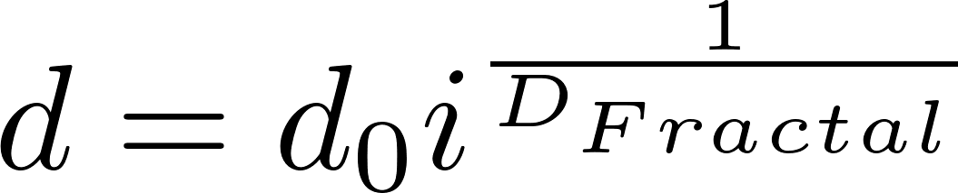
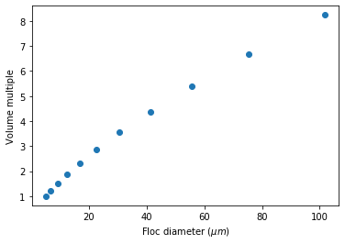
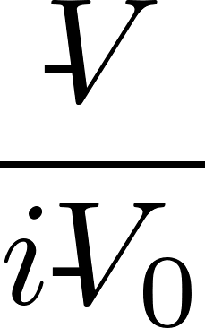
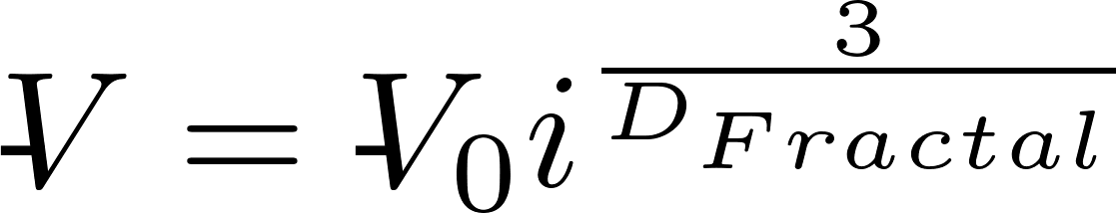
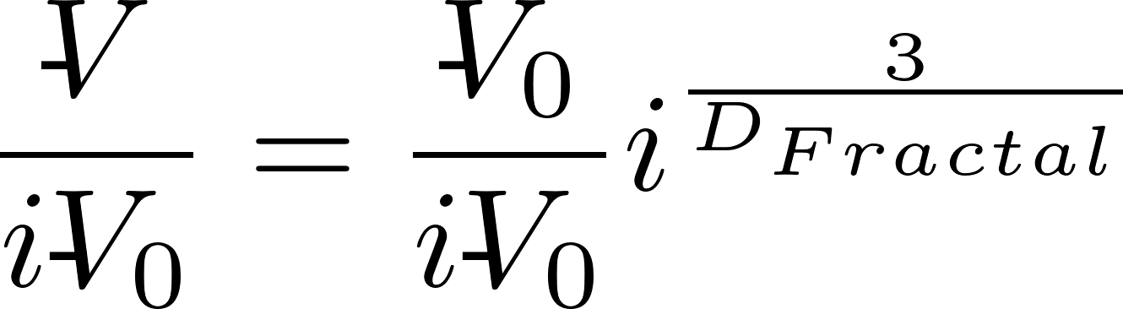
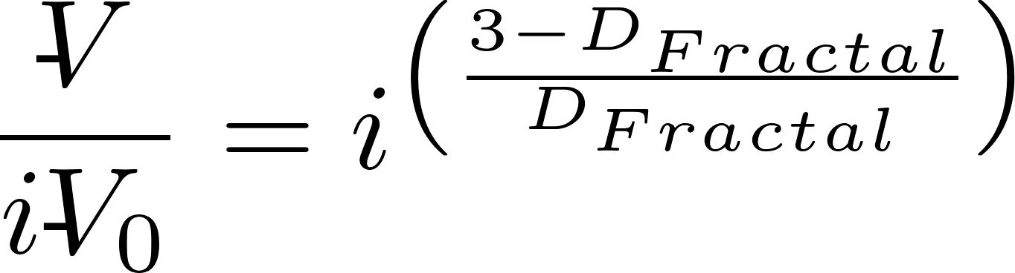
Volume occupied by flocs increases as flocs increase in size
Big flocs occupy more volume!
i is number of primary particles
Notes:
The volume occupied by the particles increases rapidly as the flocs increase in diameter.
The analysis below is for doubling collisions
max_collisions = 10
i_collisions = np.linspace(0,max_collisions,max_collisions+1)
i_particles = 2**i_collisions
d_clay = 5 * u.um
D_fractal = 2.3
d_floc = d_clay * i_particles**(1/D_fractal)
volume = i_particles**((3-D_fractal)/D_fractal)
plt.plot(d_floc,volume,'o')
plt.xlabel(r'Floc diameter ($\mu m$)')
plt.ylabel('Volume multiple')

Slide 18
Reducing the capture velocity on the plate settlers increases filter run times!
Big flocs fill a filter much quicker than the same mass of clay in smaller flocs
Reducing the plate settler capture velocity removes ever smaller flocs and it is the largest flocs that occupy the most volume per mass of clay
Plate settler capture velocities must have a significant impact on filter run times!

Slide 19
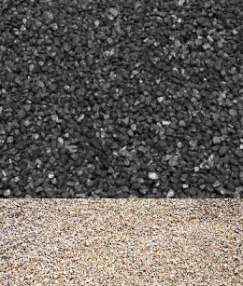
Why might larger media (anthracite on top of sand) help?
The active filtration zone moves progressively down through the filter bed
This suggests that the sand under anthracite in a dual media filter is completely inactive (research is required)!
Bigger pores are able to hold more flocs with less head loss (see filtration model!)
The sand may be included due to a misapplication of the clean bed filtration models
It is possible that we’ve had 100 years of misguided filter design because we didn’t understand the physics

Slide 20
Summary
Flocs are the filters in sand filters too!
Flocs occupy a few percent of the void volume in a loaded filter
Head loss is close to linear with time
Head loss from constrictions is due (at least in part) to expansions!
Larger sand (or anthracite) have larger pores that can hold more particles for the same head loss

Slide 21
Parting challenge
Explain how a clay particle can be captured by a sand filter.
If the flow rate through a filter is increased, do you expect the mass of particles that it can capture before breakthrough will increase or decrease? Why? Explain what is happening at the level of the constriction.

